Slide 1
Module 1
Evolution of Parallel Architectures

Slide 2
Overview
Goal: Faster Computers
Parallel Computers are one solution
Includes
  Algorithms
  Hardware
  Programming Languages
We will integrate all 3 together

Slide 3
Parallelism in Sequential Computers
– also speedup --
Interrupts
I/O Processors
Multiprocessing
High-speed block transfers
Virtual Memory
Pipelining
Multiple ALU’s
Optimizing Compilers

Slide 4
Problems: Parallelism in SISD
Pipelining
Jumps (conditional branches)
Solutions
  Look ahead
  Multiple fetches
  Good compilers

Slide 5
Multiple ALU’s
Resource conflict
  2 concurrent instructions need to use same ALU or store result to same register
Data Dependencies
  One instruction needs result of another
  Race conditions

Slide 6
Compiler Problems
Compiler tries to re-order instruction to achieve concurrency (parallelism)
Not easy to program
What about a compiler that takes sequential program that creates code for parallel computer?

Slide 7
Flynn’s Categories
Based on Instruction & Data Streams
SI – Single Instruction streams
MI – Multiple Instruction streams
SD – Single Data
MD -- Multiple Data

Slide 8
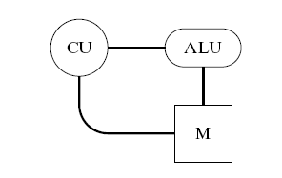
Flynn’s 4 Categories
SISD:
Traditional sequential computer
Von Neumann model
Fetch/Execute cycle
  Instruction fetch
  Instruction decode and increment the program counter
  Effective operand address calculation
  Operand fetch
  Execute
  Store result
A typical von Neumann Architecture

Slide 9
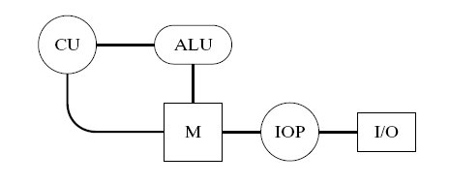
Flynn’s 4 Categories
SISD:
I/O processors provide concurrency between fast I/O devices and the CPU
  Allow CPU and IOP to access main memory directly
Adding an I/O Processor

Slide 10
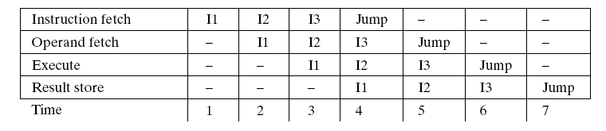
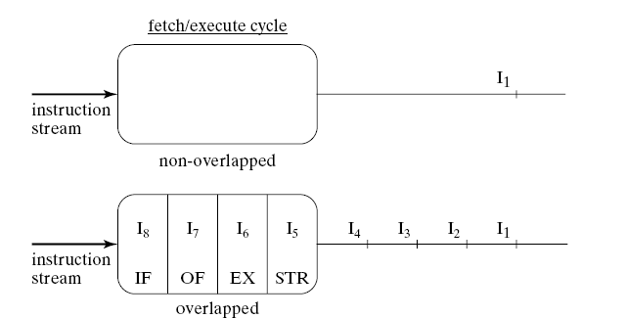
Flynn’s 4 Categories
SISD:
Pipelining introduces “covert parallelism” into the SISD architecture
Overlapped fetch/execute cycle for an SISD Computer
Comparison of SISD pipelined vs. non-pipelined fetch/execute cycle

Slide 11
Flynn’s 4 Categories
SIMD:
One instruction used to operate on multiple data items
Vector computers
Each PC executes same instruction but has own data set
True vector computers must work this way
Other can “simulate” SIMD
Synchronous

Slide 12
MIMD:
Multiple “independent” PC
Each PC has own instruction stream and own data
Work “asynchronously” but synchronization is usually needed periodically
MISD:
Not really a useful model
MIMD can simulate MISD

Slide 13
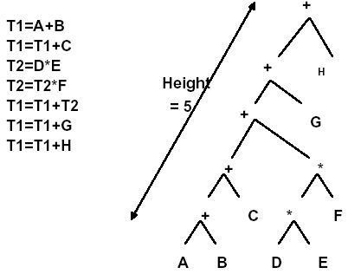
Evaluation of Expressions
Exp = A+B+C+(D*E*F)+G+H
Using an in-order traversal, the following code is generated by a compiler to evaluate EXP.

Slide 14
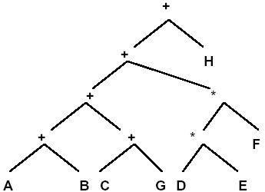
Evaluation of Expressions
Using Associativity and Commutativity laws the expression can be reordered by a compiler algorithm to generate code corresponding to the following tree
What is significance of tree height?
Height = 4
This is the most parallel computation for the given expression.

Slide 15
SIMD (Vector) Computers
Basis for Vector Computing
Loops!!
Iterations must be “independent”
True SIMD
One CPU (control unit) + multiple ALU’s, each with a memory (can be shared memory)
Pipelined SIMD
ALU’s work in a pipelined manner, not independently

Slide 16
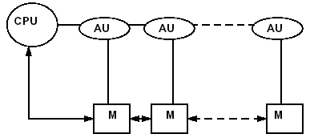
Evolution of Computer Architectures Continued
“True” Vector Processors
Single-Instruction Stream Multiple-Data Stream
SIMD
Multiple arithmetic units with single control unit.
A Typical True SIMD Computer Architecture

Slide 17
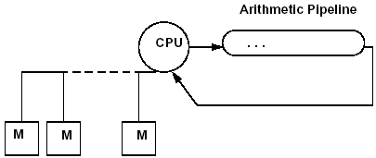
Pipelined Vector Processors
Pipelined SIMD
Pipelined arithmetic units with shared memory
A Typical Pipelined SIMD Computer Architecture

Slide 18
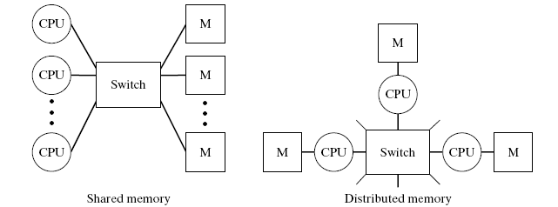
MIMD (Multiprocessor) Computers
2 Variants
Shared Memory
Distributed Memory (fixed connection)

Slide 19
Interconnection Networks
Physical connections among PCs or memory
To facilitate routing of data & synchronization
SIMD: sharing of data & results among ALU’s
MIMD: Defines the model of computing!!!
Transfers to the network as switch

Slide 20
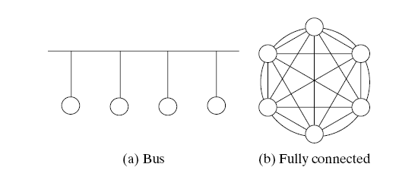
Interconnection Networks
Two possible interconnection networks:
Some form of interconnection network is needed by all parallel architectures. We will study these in detail later.

Slide 21
Application to Architecture
A different approach and/or solution is necessary for different architectures
As we have seen, some problems have obvious parallelism, others don’t

Slide 22
Interconnection NW -- MIMD
Topology, structure => performance
Performance determined by level of concurrency
  Concurrent communication
  More concurrency => More complexity
  =>More cost

Slide 23
Pseudo Code Conventions
Sequential
  Similar to Pascal or C
SIMD
MIMD
Conventions are necessary for indicating parallelism; also for compilers

